Slide 1
ATAI
Advanced Techniqueof Artificial Intelligence
ATAI
ChongqingUniversity _{AdvancedTechniqueof}
of Technology Artificial Intelligence
Chongqing University of
Technology
Chongqing University ^{ATAI}
_{of Technology} Advanced Techniqueof
Artificial Intelligence
Chongqing University of Technology
Chongqing University of Technology
Breaking Determinism: Fuzzy Modeling of Sequential Recommendation Using Discrete State Space Diffusion Model
Code: None
2024.12.29 •ChongQing
—— NeurIPS_2024
Reported by Shiyan Wu
1

Slide 2
ATAI
AdvancedTechniqueof
Artificial Intelligence
ATAI
ChongqingUniversity _{AdvancedTechniqueof}
of Technology Artificial Intelligence
ChongqingUniversity of Technology
Motivation
1.Because user behavior in reality is characterized by randomness and unpredictability, traditional models struggle to accurately capture the evolution of user interests.
2.Common diffusion models (such as DDPM) operate in continuous domains, where the introduction of noise may lead to information distortion. Discrete state space diffusion models are more suitable for handling discrete data and can avoid information loss.

Slide 3
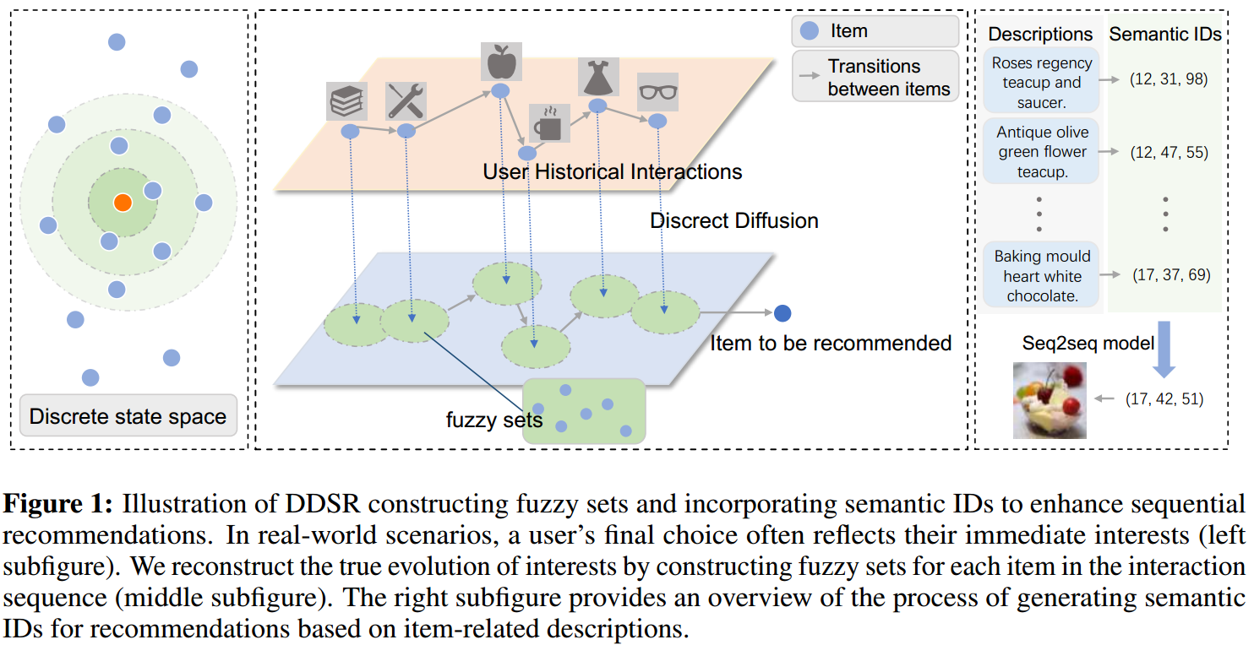
ChongqingUniversity of Technology
ATAI
AdvancedTechniqueof
Artificial Intelligence
ATAI
ChongqingUniversity _{AdvancedTechniqueof}
of Technology Artificial Intelligence
Overview

Slide 4
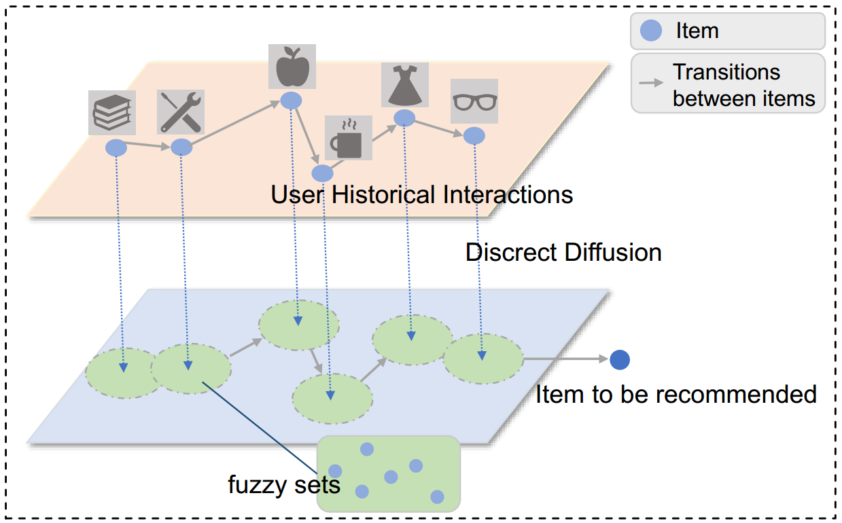
ChongqingUniversity of Technology
ATAI
AdvancedTechniqueof
Artificial Intelligence
ATAI
ChongqingUniversity _{AdvancedTechniqueof}
of Technology Artificial Intelligence
Method
(1)
(2)
(3)
(4)

Slide 5
ChongqingUniversity of Technology
ATAI
AdvancedTechniqueof
Artificial Intelligence
ATAI
ChongqingUniversity _{AdvancedTechniqueof}
of Technology Artificial Intelligence
Method
(5)
(6)
(7)

Slide 6
ATAI
AdvancedTechniqueof
Artificial Intelligence
ATAI
ChongqingUniversity _{AdvancedTechniqueof}
of Technology Artificial Intelligence
ChongqingUniversity of Technology
Experiments

Slide 7
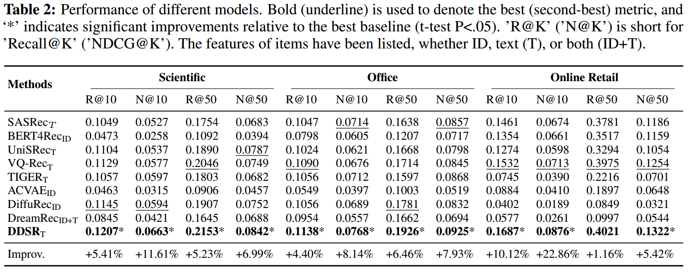
ATAI
AdvancedTechniqueof
Artificial Intelligence
ATAI
ChongqingUniversity _{AdvancedTechniqueof}
of Technology Artificial Intelligence
ChongqingUniversity of Technology
Experiments

Slide 8
ATAI
AdvancedTechniqueof
Artificial Intelligence
ATAI
ChongqingUniversity _{AdvancedTechniqueof}
of Technology Artificial Intelligence
ChongqingUniversity of Technology
Experiments

Slide 9
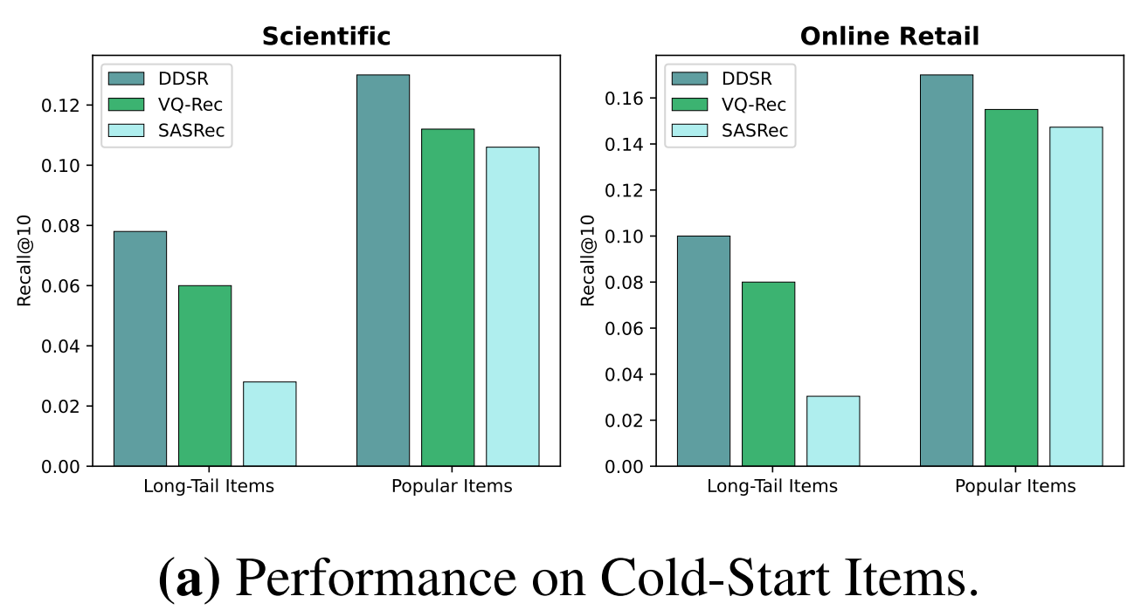
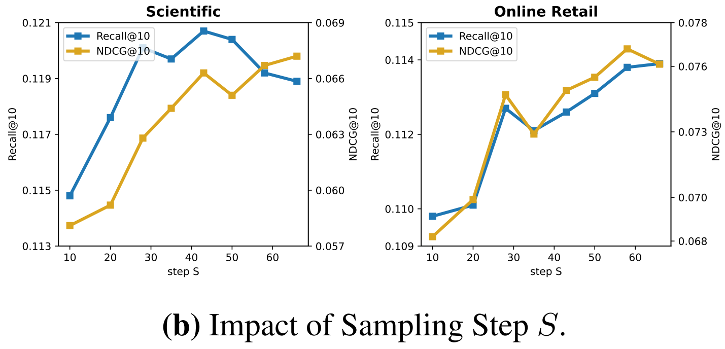
ATAI
AdvancedTechniqueof
Artificial Intelligence
ATAI
ChongqingUniversity _{AdvancedTechniqueof}
of Technology Artificial Intelligence
ChongqingUniversity of Technology
Experiments

Slide 10
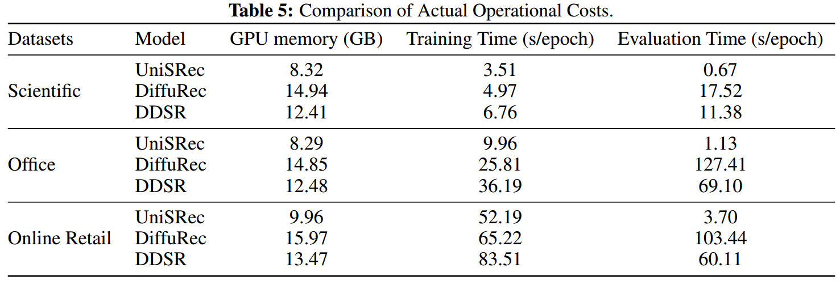
ATAI
AdvancedTechniqueof
Artificial Intelligence
ATAI
ChongqingUniversity _{AdvancedTechniqueof}
of Technology Artificial Intelligence
ChongqingUniversity of Technology
Experiments

Slide 11
ChongqingUniversity of Technology
ATAI
AdvancedTechniqueof
Artificial Intelligence
ATAI
ChongqingUniversity _{AdvancedTechniqueof}
of Technology Artificial Intelligence
Thanks!

